Slide 1

PAGE RANK ALGORITHM

Slide 2
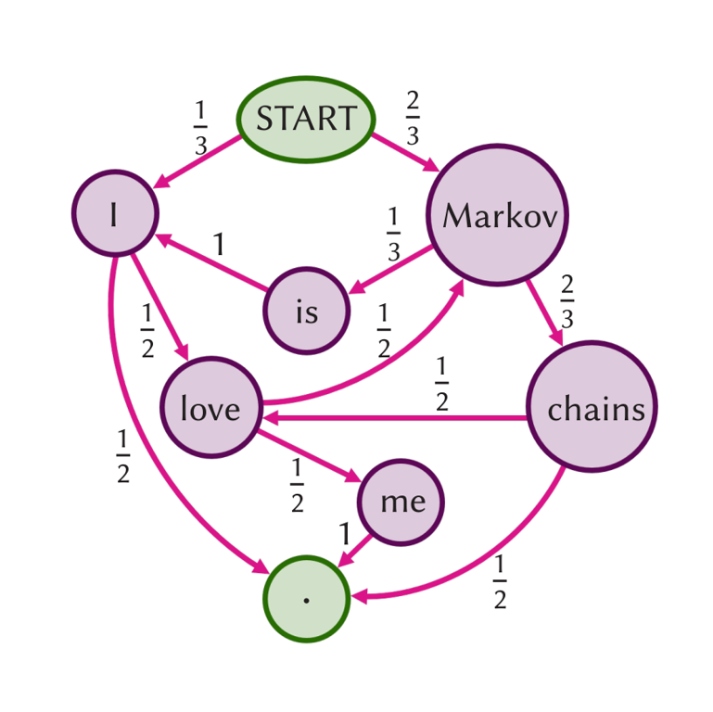
MARKOV CHAIN
DEFINITIONS
Mathematical model for state transitions based on probabilistic rules.
Future states determined solely by current state, regardless of path.
Key feature: "Memory-less" property distinguishes it from other stochastic processes.

Slide 3
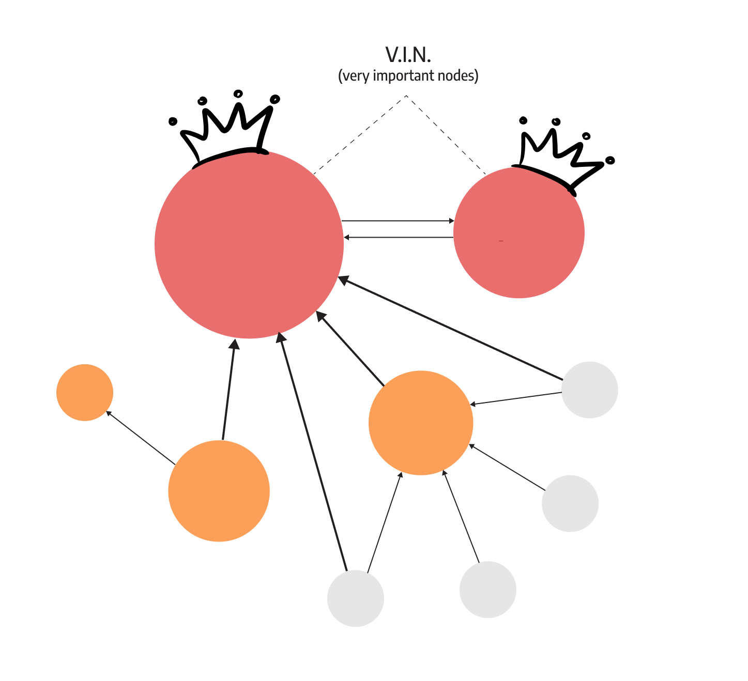
PAGERANK
Google algorithm evaluates webpage significance based on inbound link quality and quantity.
Treats incoming links as votes, with more high-quality links leading to higher influence.
Facilitates higher rankings for websites by leveraging importance of inbound links.

Slide 4
HISTORY AND OVERVIEW
Traditional ranking
Based on keyword frequency and metadata resulted in low-quality results and manipulation
PageRank
Developed by Larry Page and Sergey Brin at Google
Considers web structure, assigning scores based on inbound links' quality and quantity

Slide 5
Project Goals
Implement and analyze PageRank algorithm using sampling and iterative methods to understand their effectiveness and practical implications in web search algorithms.

Slide 6
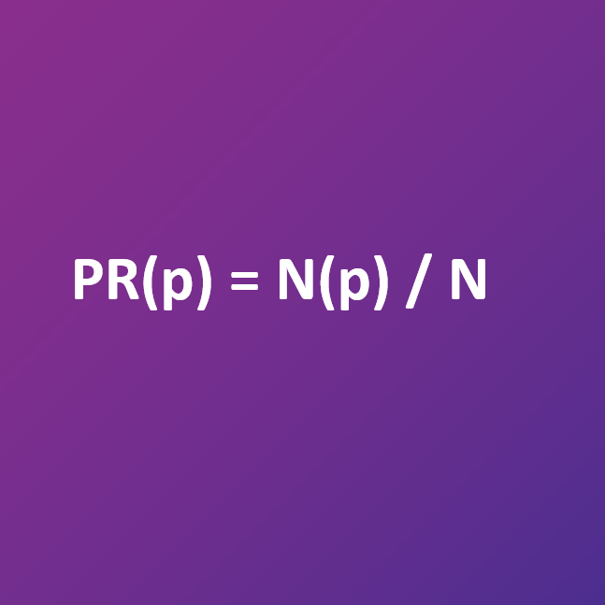
SAMPLING METHOD
METHODS
Randomly selects pages based on a model simulating a random surfer behavior.
Estimates PageRank scores by repeatedly selecting pages and recording their frequencies until convergence.

Slide 7
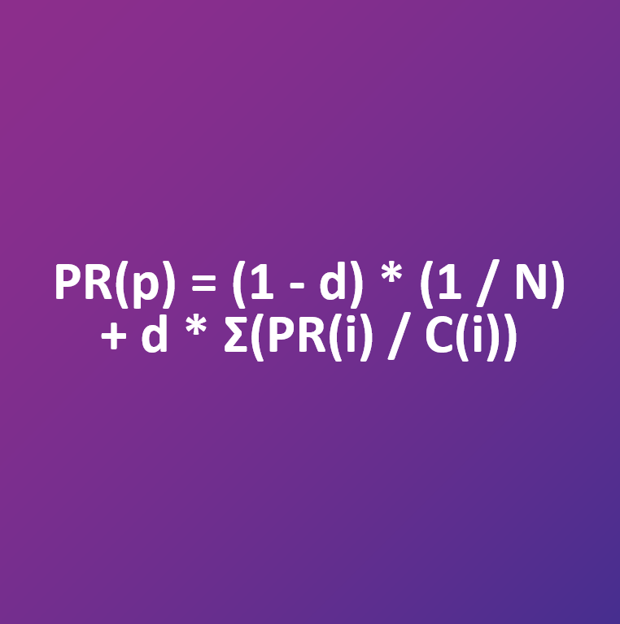
ITERATIVE METHOD
Continuously updates PageRank values until stabilization.
Starts with initial estimates and refines through multiple iterations based on transition probabilities.

Slide 8
Main Function
Validates command-line arguments.
Calls crawl function to parse HTML files.
Computes PageRank using sampling and iterative methods.
Prints PageRank results.

Slide 9
Crawl Function
Parses HTML files to identify inter-page links.
Constructs a dictionary with pages as keys and linked pages as values.

Slide 10
Transition Model
Calculates probability distribution for transitioning between pages.
Uses damping factor to select next page

Slide 11
Sampling Function
Estimates PageRank values through random sampling.
Starts with a randomly selected page and iterates according to transition model probabilities.
Returns a dictionary with page names and estimated PageRank values.

Slide 12
Iterate function
Estimates PageRank values iteratively until convergence.
Initializes and updates PageRank values for each page.
Returns a dictionary with page names and calculated PageRank values

Slide 13
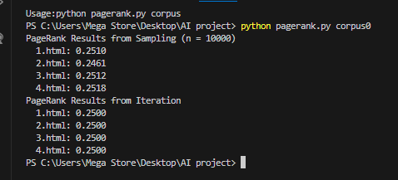
Output

Slide 14
Thank you

